Slide 1
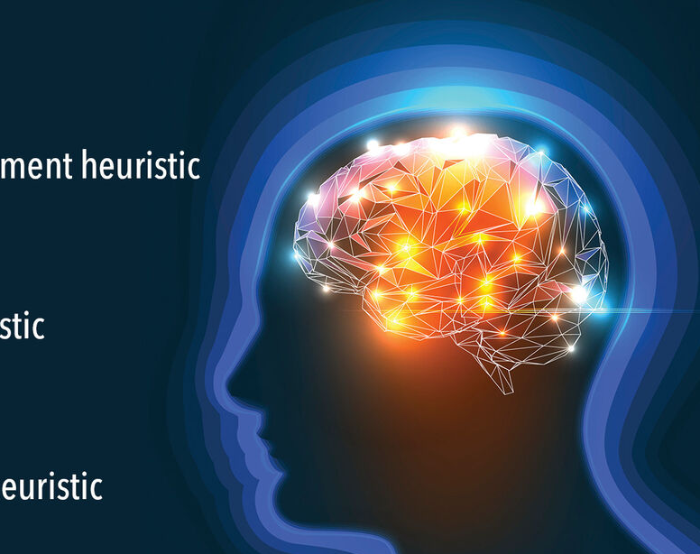
Heuristic Search
Introduction
Week 8

Slide 2














Contents
Classes of Problems
Random Numbers and the Exponent Function
Heuristic Search
  Search Problem
  Fitness
  Fitness Landscape
  Global and Local Optima
  Representation
Travel Salesperson Problem
Other Paradigm Problems
Hill Climbing
  Random Mutation Hill Climbing
  Small Change

Slide 3










Classes of Problems
Problems can be solved in polynomial time
Polynomial time is the number of steps required to complete the algorithm
P problem is a polynomial time problem where a problem is called tractable
NP problem (which stands for non-deterministic polynomial time) is a set of problems whose solutions can be verified in polynomial time

Slide 4









NP-Complete and NP-Hard
NP- This class contains decision problems (yes/no answers) for which a solution can be verified in polynomial time.
NP-hard - These are problems that are at least as hard as the hardest problems in NP. They are not necessarily in NP themselves (they don’t need to be decision problems and might not be verifiable in polynomial time).
NP-complete - These are problems that are both in NP and NP-hard. An NP-complete problem is as hard as any problem in NP, and if we can solve one NP-complete problem in polynomial time, then every problem in NP can also be solved in polynomial time (meaning P = NP ).

Slide 5

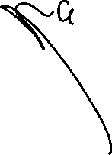





Problems which can
be solved in polynomial
time using a “magic box”
(Non-deterministic)
NP
P
Problems which
can be solved in
polynomial time

Slide 6




If a polynomial time algorithm is found for any problem in
NP-Complete then every problem in NP can be solved in polynomial time
I.e. P = NP
NP
P
NP-Complete
The “hardest”
problems in NP

Slide 7






Examples of Problems
Travelling Salesman Problem (TSP) (Optimisation version)
  Description: Given a list of cities and the distances between each pair of cities, find the shortest possible route that visits each city exactly once and returns to the starting city.
  Why it’s NP-hard: It’s not a decision problem; it’s an optimisation problem. While a decision version (e.g., “Is there a route shorter than k?”) is NP-complete, finding the actual minimum route is NP-hard.
Boolean Satisfiability Problem (SAT)
  Description: Given a Boolean expression, determine if there is an assignment of true/false values to variables that make the expression true.
  Why it’s NP-complete: SAT was the first problem proven to be NP-complete (Cook's theorem). A solution can be verified in polynomial time, but finding one requires checking many combinations.

Slide 8







Examples of Problems
Are you sure the Travelling Salesman Problem is NP-hard, or is it NP-complete?
What about the following problems?
  Bin Packing?
  Scales Problem/Knapsack Problem?
  Job Shop Scheduling Problem
  Graph Colouring Problem

Slide 9





Heuristic Search
Some problems (NP-Hard) cannot be solved in a straightforward manner
We need to develop approximation algorithms to solve these problems
A type of method called Heuristic Search can be used to try and find a solution
We search for the best solution from a very large number of potential solutions
We score the worth of each solution using a Fitness Function

Slide 10

Heuristic Search
A heuristic is a “rule of thumb” or some loose set of guidelines
  Getting out of a maze by keeping your hand against the maze wall
In Artificial Intelligence, these are used to improve the performance of methods, in our case, search methods
  Expert knowledge
  Common sense

Slide 11



There is no Free Lunch!
There is a theorem in heuristic search called the No Free Lunch Theorem
  This is not a joke!
This theorem states that just because method X is great at solving problem Y, it might be no use at solving problem Z
  Even if problem Y and Z are very, very similar...
This makes our lives as implementers of these types of algorithms rather difficult
The correct use of heuristic search methods is almost like an “art”

Slide 12
Random Numbers
A random number is a number chosen/generated by chance
A uniformly distributed real-valued random number between a and b has an equal chance of assuming any of the values between a and b
  We use the notation UR(a,b)
  We use UI(a,b) for uniformly distributed random integers
If an event has an x% chance of occurring, then we generate UR(0,1) and see if it is less than x/100
  83.2% is equivalent to 0.832

Slide 13





Random Numbers
We need random numbers for various search-based methods
Some of these methods decide on what action to take based on random numbers
This is rather like tossing a coin to decide which way to go
Methods based on generating random numbers are often referred to as Stochastic or Monte-Carlo methods

Slide 14

The Exponential Function
The exponential function, exp(x), is a mathematical function that is very important in all areas of mathematics
This function raises the mathematical constant e to the power of x
  e = exp(1) = 2.718... (infinite number of decimal places [d/p])
  exp(-2) = 1/e² = 0.135 (3 d/p)
  e has an infinite number of decimal places and is a Transcendental number, as is π
  All possible sequences will eventually occur…
This function is used in the Stochastic Hill Climbing and Simulated Annealing algorithms

Slide 15








Search Problems
Many problems can be thought of as searching through candidate solutions to find one that is optimal
  Systematically search through potential solutions without considering all of them…
Need some way to evaluate the fitness of the candidate solutions
  Optimal = fittest
Some sense of the adjacency (similarity) of solutions (or neighbourhood)

Slide 16








Discrete and Continuous Problems
The definition for discrete is that it is countable, finite and numeric. Meaning, it is a number with an identified minimum and maximum.
Continuous, on the other hand, are defined as numbers or a numeric date that can take on any value.
What are discrete and continuous problems? Examples:
  Combination and permutation.
  Grouping students in a few groups.
  Clustering elements based on their features.
  Finding the optimal value for x and y to maximise profit.
  Get the sequence of jobs that optimises the cost.
  Find the roots of a real-valued function.

Slide 17
Fitness
The fitness of a solution that is measurable.
Examples:
  A good car is defined as the least number of breakdowns in 2 years. Fitness = number of breakdowns in 2 years (minimise).
  A bullet train. Fitness = Maximum speed (km/h)
  A good singer. Fitness = can sing a perfect pitch more than 3 genres of songs.
  The Travel Salesperson Problem. Fitness = A route with the minimum distance! (minimise)

Slide 18










Fitness
In order to search for a solution, we must be able to compare potential solutions
E.g. Is solution s₁ better than solution s₂?
  Thus, we have the concept of fitness
We must derive a function (the fitness function) that maps a solution to a value that rates how good the solution solves the problem at hand
We either try and maximise or minimise the fitness
A slight change in solution quality should result in a corresponding change in the fitness
  Solution quality goes down → Fitness goes down
  Solution quality goes up → Fitness goes up

Slide 19


Fitness Landscape
It can be helpful to think of searching a landscape of solutions where:
  The x and y coordinates represent a particular solution
  Altitude (z axis) represents the fitness of that solution
This leads to the analogy that we wish to search for or climb peaks
Describing the nature of a landscape characterises (in an abstract way) classes of problem

Slide 20
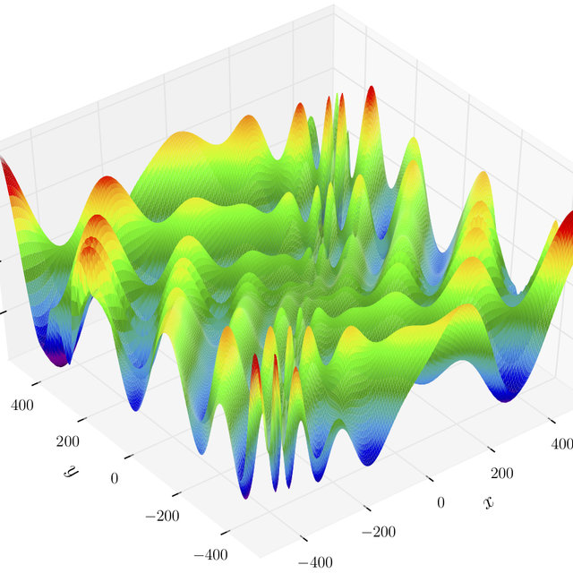
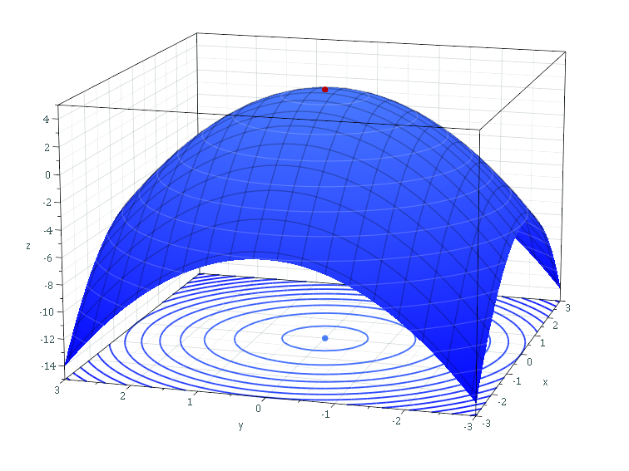
Fitness Landscape
Smooth and regular spaces are easy to search
Irregular spaces are difficult to search

Slide 21










Global and local optima
The global optimum is the point or points in the search space with the best objective function evaluation
A local optimum is the point or points in a subset or section of the search space with the best objective function evaluation
Note that the subset or section of the search space in question may contain the global optima
Many search techniques can find local optima but get “stuck” at them and cannot move on to find the global optima

Slide 22
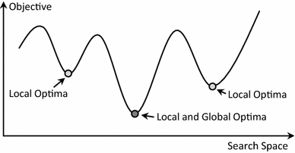
Global and local optima - Minimisation

Slide 23

Let’s take a break - 5 minutes!

Slide 24
Representation
When we are trying to solve a search-based problem, we need a way to represent a potential solution
This is usually a mathematical and/or data structure-based way of describing the solution to a problem
A good representation:
  Should be a one-to-one mapping
  No redundancy
  No ambiguities
  All potential solutions should be represented

Slide 25



Representation - Examples
Sequence of binary numbers.
Where 0=Mehmet, 1=Zairul
A list of groups
Where we encode red = 1, blue = 2, green = 3
Dataset:
1 | 1 | 0 | 0 | 0 | 0 | 1
ModA | ModH | ModL | ModB | ModQ | ModP | ModW
Dataset:
red | blue | blue | green | blue | green | red
std1 | std3 | std7 | std2 | std9 | std4 | std11
1 | 2 | 2 | 3 | 2 | 3 | 1

Slide 26
Representation - Examples
This is a solution
Mehmet: ModL, ModB, ModQ, ModP
Zairul: ModA, MohH, ModW
where red = 1, blue = 2, green = 3, therefore:
1 | 1 | 0 | 0 | 0 | 0 | 1
ModA | ModH | ModL | ModB | ModQ | ModP | ModW
This is the dataset
Where we evaluate the solution using a fitness function f(x_{i})
Std2
Std7
Std9
1 | 2 | 2 | 3 | 2 | 3 | 1
This is a solution
Std2
Std4
std1 | std3 | std7 | std2 | std9 | std4 | std11
This is the dataset
Std1
Std11

Slide 27





The Travel Salesman Problem
The Travelling Salesman Problem is well known to be NP-Hard
This means there is no direct algorithmic or mathematical way to derive a solution in polynomial time
  The search space (as we will see later) is O(N!)
  One of the worst that we have seen to date…
We need approximate or Heuristic search methods to find a solution (or partial solution)
  Genetic Algorithm
  Hill Climbing
  Simulated Annealing
  Ant Colony
  Etc...

Slide 28
The Travel Salesman Problem
A salesperson has to visit N cities as part of their job
The aim is to start off at one of the cities, visit each city exactly once and then to arrive back at the starting city
  This is called a tour
The objective is to find a tour where the sum of the total distance travelled is a minimum

Slide 29
The Travel Salesman Problem
In order to solve the TSP, we need to know how “far” each city is from each other
We will use the notation d(i,j) to represent the distance from city i to city j
Note:
  d(i,j)=d(j,i), i.e. the distance from city i to city j is the same as from city j to city i
  d(i,i) = 0, i.e. , a city is zero distance from itself
Example solutions for TSP can be:
  1, 2, 3, 4, 1 – fitness = d(1,2)+d(2,3)+d(3,4)+d(4,1)
  2, 3, 1, 4, 2 – fitness = d(2,3)+d(3,1)+d(1,4)+d(4,2)
1
4
3
5
3
2
2
1.5
2.5
4
d(1,2)=3
d(1,3)=4
d(1,4)=5
d(2,3)=2
d(2,4)=2.5
d(3,4)=1.5

Slide 30
TSP Representation
A natural way to represent a solution to the TSP problem is to represent a tour as a permutation of the integers 1,2,...,N
  Starting at the left-hand side of the permutation and visiting the cities in the specified order, moving from left to right
  This will ensure that we do not visit any city twice
A permutation is defined as a shuffling of a set of objects
  A permutation of A,B,C,D is B,C,A,D
  A permutation of 1,2,3,4 is 4,1,2,3
If we have N objects, then there are N! possible permutations

Slide 31

Other Paradigm Problems
Bin Packing - https://youtu.be/vUxhAmfXs2o
Scales Problem - https://youtu.be/-n-A5qcO398
Please watch the YouTube video on the Scales Problem, we’ll do an exercise on this problem next week!

Slide 32

Hill Climbing

Slide 33
Hill Climbing
Hill Climbing (HC) algorithm is an iterative search method that aims to find a point in the search space that maximises some objective function (fitness)
The HC algorithm starts off at some random point in the search space
It then looks randomly at its close neighbours until it finds one with a better fitness
The hill climbing algorithm then continues searching for improvement from this new point

Slide 34
Hill Climbing

Slide 35
Hill Climbing
The idea is that the algorithm locates points that lead up (or down) a slope in the fitness space
This is rather like the analogy of a hillwalker trying to climb up a hill in the fog
They feel around themselves until they find a nearby direction that goes up
They then move to this higher point and continue searching
There are three types of HC:
  Random Mutation Hill Climbing (RMHC). RMHC is a greedy search method.
  Random Restart Hill Climbing (RRHC) – We’ll learn next week
  Stochastic Hill Climbing (SHC) – We’ll learn next week

Slide 36
Hill Climbing
For Random Mutation Hill Climbing, we need:
  A random starting point
  A small change
  How many iterations do we run the algorithm for

Slide 37
Hill Climbing – Small Change
A small change can be defined as perturbation made to the current solution to generate a new solution.
Current solution
A | C | F | B | D | E
Small change strategy: randomly swap elements in the current solution i.e., A and B.
new solution
B | C | F | A | D | E

Slide 38
Hill Climbing - RMHC
The Random Mutation Hill Climbing algorithm is as follows:
Algorithm 1. RMHC
Input: ITER- the number of iterations to run for
1) Let S be a random point in the search space,
let F be its fitness(S)
2) For i = 1 to ITER (number of iterations)
3) Let S’ be a random point close to S (small change)
4) Let F’ be its fitness (S’)
5) If F’ is better than F Then
6) Let S = S’ and Let F = F’
7) End If
6) End For
Output: S- a solution

Slide 39
Random Start and Small Change
Algorithm 2. RandomStart(n)
Input: n- the number of weights, a-1000, b-9999
1) Let S be a n length binary string (or array)
2) For i = 1 to n
3) Let s_{i} = UI(a,b)Mod 2
4) End For
Output: S- a random solution to Scales
Algorithm 3. SmallChange(S_{old})
Input: S_{old}- A binary string of length n
1) Let S = S_{old}
2) Let i be UI(1,n)
3) If s_{i} = 0 Then Let s_{i} = 1 Else Let s_{i} = 0
Output: S- a solution to Scales close to S_{old}

